Slide 1

Containing the Madness
An Introduction to Containers, Docker, and Maybe Kubernetes

Slide 2


Jason van Brackel
Senior Solutions Architect
@jasonvanbrackel
Github: jasonvanbrackel
jvb on Slack

Slide 3
A Really Brief History of Application Architecture

Slide 4
A Brief History of Application Architecture
Monoliths
N-Tier Applications

Slide 5


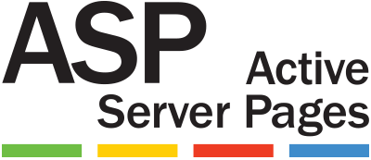

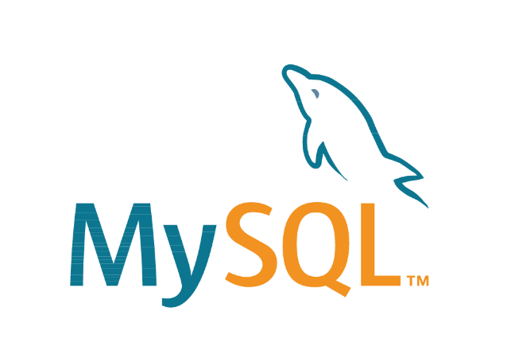
Monoliths
Contains Units for
  UI
  Business Logic
  Persistence / Database
  Sometimes just one code base

Slide 6
Monoliths
Easy to Build
Easy to Deploy
Difficult to Scale
Difficult to Maintain

Slide 7
Monoliths – Development

Slide 8
Monoliths – Deployment

Slide 9
Monoliths - Challenges
Scale
Security
Brittle

Slide 10
Monoliths - Challenges
OS Updates
Framework Updates
DLL Hell

Slide 11
Virtual Machine

Slide 12
Monoliths – Development

Slide 13


N-Tier Applications
Contains Units for
  UI
  Business Logic
  Messaging
  Persistence / Database

Slide 14
N-Tier Applications
Easy to Build
Difficult to Deploy
Easier to Scale
Easier to Maintain

Slide 15
N-Tier Applications - Development

Slide 16
N-Tier Applications – Deployment

Slide 17
N-Tier - Challenges
Scale
Security
Framework Version Maintenance
OS Compatibility
It Works on My Machine
VM Image Sprawl and Maintenance
Firewall Configuration

Slide 18
Microservices
SPA
Smaller Services
Running in their own processes
Ephemeral
Products vs. Projects
Smart Endpoints
Dumb Pipes
Decentralized Governance
Decentralized Data management

Slide 19
Microservices - Pros and Cons
Pros
Cons
Simple Functionally
Performance
Scale
  Independent Deployment
  Fast Deployment
Cross-functional teams
Self Organizing
Self Governing
  Technology Diversity
Difficult Operationally
Immature
Distribution
Difficult introspection
Stateless
Eventually Consistent
Troubleshooting

Slide 20

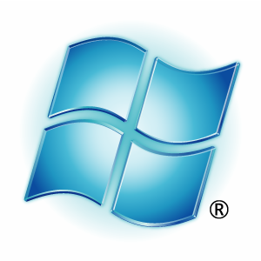
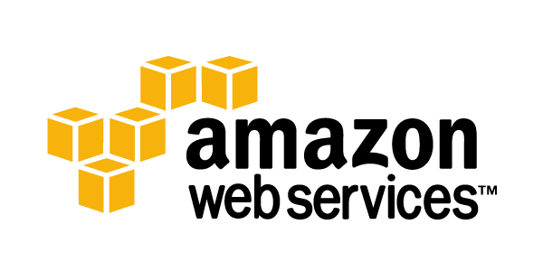
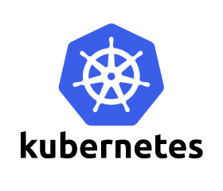


Microservices - Technology
Container as a Service(CaaS)
Platform as a Service (PaaS)
Container Automation

Slide 21
A Not as Brief History of Containers

Slide 22
A Not as Brief History of Containers
Chaning the root directory of a process and all of its children to a new location in the filesystem
The beginning of process isolation
1979: Unix V7
chroot Introduced
A Brief History of Containers: From 1970s chroot to Docker 2016 - http://blog.aquasec.com/a-brief-history-of-containers-from-1970s-chroot-to-docker-2016

Slide 23
A Not as Brief History of Containers
FreeBSD Jails allows administrators to partition a FreeBSD computer system into several independent, smaller systems – called “jails” – with the ability to assign an IP address for each system and configuration.
2000: FreeBSD
Jails
A Brief History of Containers: From 1970s chroot to Docker 2016 - http://blog.aquasec.com/a-brief-history-of-containers-from-1970s-chroot-to-docker-2016

Slide 24
A Not as Brief History of Containers
FreeBSD Jails allows administrators to partition a FreeBSD computer system into several independent, smaller systems – called “jails” – with the ability to assign an IP address for each system and configuration.
2001: FreeBSD
Jails
A Brief History of Containers: From 1970s chroot to Docker 2016 - http://blog.aquasec.com/a-brief-history-of-containers-from-1970s-chroot-to-docker-2016

Slide 25
A Not as Brief History of Containers
Linux VServer is a jail mechanism that can partition resources (file systems, network addresses, memory)
Introduced in 2001, this operating system virtualization that is implemented by patching the Linux kernel.
Experimental patches are still available, but the last stable patch was released in 2006
2001: Linux VServer
A Brief History of Containers: From 1970s chroot to Docker 2016 - http://blog.aquasec.com/a-brief-history-of-containers-from-1970s-chroot-to-docker-2016

Slide 26
A Not as Brief History of Containers
Oracle released a Solaris Container that combines system resource controls and boundary separation provided by zones, which were able to leverage features like snapshots and cloning from ZFS.
The ZFS name originally stood for "Zettabyte File System
In 2005, the bulk of Solaris, including ZFS, was licensed as open-source software under the Common Development and Distribution License (CDDL), as the OpenSolaris project.
Became a standard feature in Solaris 10
2004: Oracle Solaris Containers
A Brief History of Containers: From 1970s chroot to Docker 2016 - http://blog.aquasec.com/a-brief-history-of-containers-from-1970s-chroot-to-docker-2016

Slide 27
A Not as Brief History of Containers
This is an operating system-level virtualization technology for Linux which uses a patched Linux kernel for virtualization, isolation, resource management and checkpointing.
The code was not released as part of the official Linux kernel.
2005: OpenVZ (Open Virtuzzo)
A Brief History of Containers: From 1970s chroot to Docker 2016 - http://blog.aquasec.com/a-brief-history-of-containers-from-1970s-chroot-to-docker-2016

Slide 28
A Not as Brief History of Containers
Google project designed to limit, account for and isolate resource usage
Later renamed to cgroups. Merged into the Linux kernel at 2.6.24 (24 Jan 2008)
2006: Process Containers
A Brief History of Containers: From 1970s chroot to Docker 2016 - http://blog.aquasec.com/a-brief-history-of-containers-from-1970s-chroot-to-docker-2016

Slide 29
A Not as Brief History of Containers
LXC (LinuX Containers) was the first, most complete implementation of Linux container manager.
Implemented in 2008 using cgroups and Linux namespaces,
Linux kernel without requiring any patches.
2008: LXC
A Brief History of Containers: From 1970s chroot to Docker 2016 - http://blog.aquasec.com/a-brief-history-of-containers-from-1970s-chroot-to-docker-2016

Slide 30
A Not as Brief History of Containers
Built by CloudFoundry
Their own version of LxC
Isolates environments on any operating system, running as a daemon and providing an API for container management.
Developed a client-server model to manage a collection of containers across multiple hosts
Includes a service to manage cgroups, namespaces and process life cycle.
2011: Warden
A Brief History of Containers: From 1970s chroot to Docker 2016 - http://blog.aquasec.com/a-brief-history-of-containers-from-1970s-chroot-to-docker-2016

Slide 31
A Not as Brief History of Containers
Let Me Contain That For You (LMCTFY) Open-Source version of Google's container stack, providing Linux application containers.
Applications can be made “container aware,” creating and managing their own subcontainers.
Active deployment in LMCTFY stopped in 2015 after Google started contributing core LMCTFY concepts to libcontainer.
Which is now part of the Open Container Foundation.
2013: LMCTFY
A Brief History of Containers: From 1970s chroot to Docker 2016 - http://blog.aquasec.com/a-brief-history-of-containers-from-1970s-chroot-to-docker-2016

Slide 32
Virtualization and Container Concepts

Slide 33
Virtualization
Virtual Memory
Application Virtualization (JIT / JVM)
Hardware Virtualization (VMWare / Hyper-V)
Containers (OS Virtualization)

Slide 34
Containers – OS Virtualization
Local Disk looks like a pristine copy of the OS
Memory appears consistent with a freshly booted OS

Slide 35
Containers are not VMs
VM
Containers
App A
App A₁
App B
Windows Server Guest OS
Windows Server Guest OS
Windows Server Guest OS
App A
App A₁
App A₂
App A₃
App B
App B₁
Docker
Hypervisor (Type 2)
Windows Server (Host OS)
Windows Server (Host OS)
Server
Server

Slide 36
Containers are not VMs
VM
Containers
App A
App A₁
App B
Windows Server Guest OS
Windows Server Guest OS
Windows Server Guest OS
App A
App A₁
App A₂
App A₃
App B
App B₁
Docker
Hypervisor (Type 1)
Windows Server (Host OS)
Server
Server

Slide 37
Containers are not VMs
VM
Containers
App A
App A₁
App B
App A
App A₁
App A₂
App A₃
App B
App B₁
Docker
App A
App A₁
App A₂
App A₃
App B
App B₁
Docker
App A
App A₁
App A₂
App A₃
App B
App B₁
Docker
Windows Server Guest OS
Windows Server Guest OS
Windows Server Guest OS
Windows Server (Host OS)
Windows Server (Host OS)
Windows Server (Host OS)
Hypervisor (Type 1)
Hypervisor (Type 1)
Server
Server

Slide 38
Containers are not VMs
VMs
Containers
Hardware Virtualization
OS Isolation
Full Copy of the OS
Hypervisor responsible for maintaining isolation
OS Virtualization
Userspace and Namespace Isolation
Enough of the OS for the Application to use
Docker Daemon responsible for maintaining isolation

Slide 39
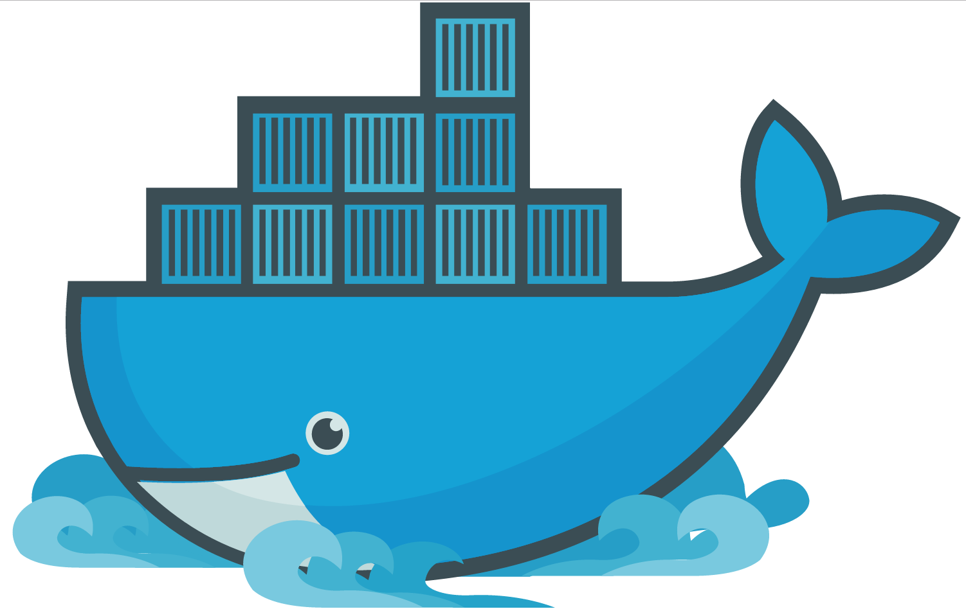
Docker

Slide 40
Docker
A company
A suite of tools for building, deploying and managing applications using Docker containers
An container engine

Slide 41
Docker Engine
It runs docker images
  docker
  dockerd

Slide 42
Docker Toolbox
A virtualized development environment to create docker images in Windows and Mac OSX
  Backed by VirtualBox
  Conflicts with Hyper-V
  Conflicts with Docker for Windows

Slide 43
Docker Machine
Install and run Docker on Mac or Windows
Provision and manage multiple remote Docker hosts
Provision Swarm clusters

Slide 44
Docker Compose
Tool for defining and running multi-container Docker applications
  Define your app’s environment with a Dockerfile
  Define services that make up your app in docker-compose.yml
  Run

Slide 45
Docker Swarm
Prior to version 1.12
  Docker Swarm is native clustering for Docker
  Turns a pool of Docker hosts into a single, virtual Docker host
  Uses the standard Docker API, any tool that already communicates with a Docker daemon can use Swarm to transparently scale to multiple hosts
Functionality folded into Docker in 1.12
  Swarm mode

Slide 46
Docker Container Fundamentals

Slide 47
Docker Container Fundamentals
  dockerd
  thin layer between containers and the kernel
Docker Daemon

Slide 48
Docker Container Fundamentals
  Developer user dockerfiles to build container images
Dockerfile

Slide 49
Dockerfile
FROM microsoft/iis
RUN mkdir C:\site
RUN powershell -NoProfile -Command \
Import-module IISAdministration; \
New-IISSite -Name "Site" -PhysicalPath C:\site -BindingInformation "*:8000:“
ADD content/ /site

Slide 50
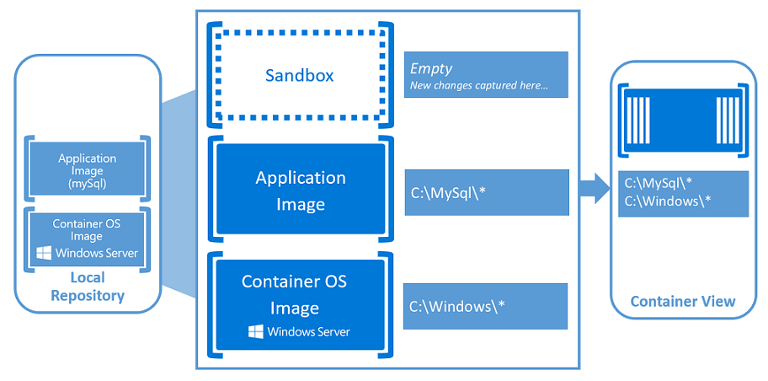
Container Fundamentals
Windows Containers - https://docs.microsoft.com/en-us/virtualization/windowscontainers/about/index

Slide 51
Docker Container Fundamentals
  Container Images are Published and Stored here
  Docker Hub is a public cloud-based container registry managed by Docker
Registry

Slide 52
Docker Architecture

Slide 53
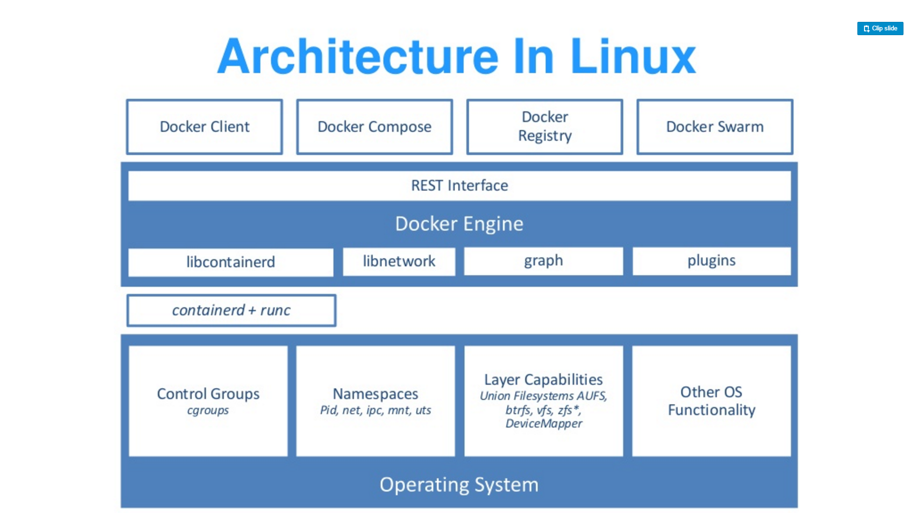
Source: “DockerCon 16: Windows Server & Docker - The Internals Behind Bringing Docker & Containers to Windows - Black Belt”

Slide 54
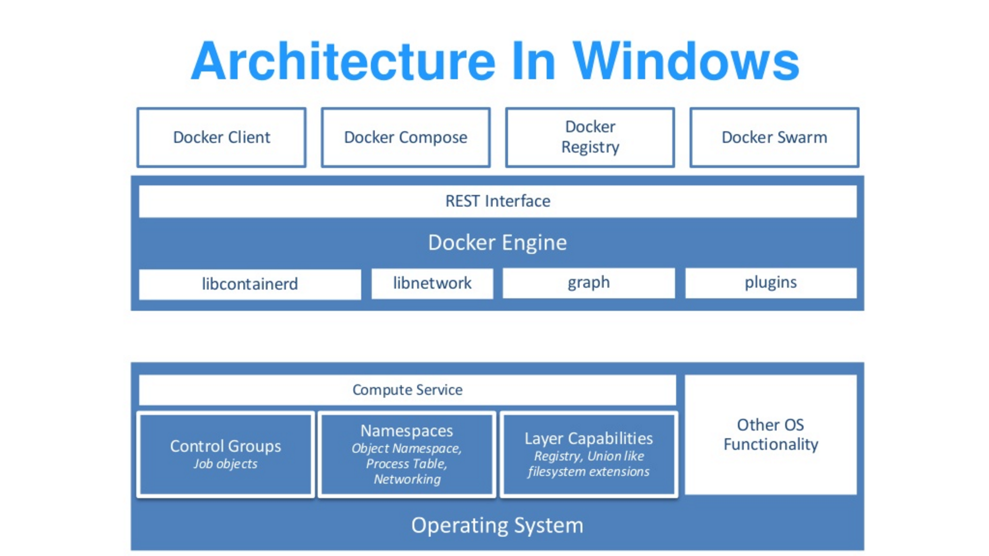
Source: “DockerCon 16: Windows Server & Docker - The Internals Behind Bringing Docker & Containers to Windows - Black Belt”

Slide 55
Docker Architecture
Docker library written in Go.
Cross-Platform Unix / Solaris / Linux / Windows
https://github.com/docker/docker/tree/master/libcontainerd
Uses underlying OS fundamentals to create containers
libcontainerd

Slide 56
Docker Architecture
Simple daemon that uses runC to manage containers
Containerd uses gRPC to expose a CRUD interface around containers
Docker Engine expands this, but also images, volumes, networks, builds, etc. using a full-blown HTTP API
runc + containerd

Slide 57
Docker Architecture
Public interface to manage running containers
Replaces containerd for Windows
Abstracts low-level kernel capabilities
https://blogs.technet.microsoft.com/virtualization/2017/01/27/introducing-the-host-compute-service-hcs/
Compute Service
Source: “DockerCon 16: Windows Server & Docker - The Internals Behind Bringing Docker & Containers to Windows - Black Belt”

Slide 58
Docker Architecture
Part of the Win32 API
Allows a group of processes to be managed as a single object
https://msdn.microsoft.com/en-us/library/windows/desktop/ms684161(v=vs.85).aspx
Job Objects
Source: “DockerCon 16: Windows Server & Docker - The Internals Behind Bringing Docker & Containers to Windows - Black Belt”

Slide 59
Docker Architecture
Extends the Job Object
New Namespace Virtualization
  Registry
  Process ID
  Object Namespace
  File system
  Network Compartments
Namespaces (Silo)
Source: “DockerCon 16: Windows Server & Docker - The Internals Behind Bringing Docker & Containers to Windows - Black Belt”

Slide 60
Docker Architecture
Kernel view of the world
  \DosDevices\C:\Windows
  \Registry
  \Device\Tcp
  \Device\Null
Similar concept to chroot
  \Silo\foo\DosDevices\C:\Windows
  \Silo\bar\DosDevices\C:\Windows
Object Namespaces
Source: “DockerCon 16: Windows Server & Docker - The Internals Behind Bringing Docker & Containers to Windows - Black Belt”

Slide 61
Docker Architecture
Windows Applications expect NTFS semantics
Building an union FS with NTFS semantics is hard
Hybrid Model
  NTFS partitions per container
  Symlinks to layers on the host file system
File system
Source: “DockerCon 16: Windows Server & Docker - The Internals Behind Bringing Docker & Containers to Windows - Black Belt”

Slide 62
Docker Architecture
Small file system
True union FS
Windows Registry
Source: “DockerCon 16: Windows Server & Docker - The Internals Behind Bringing Docker & Containers to Windows - Black Belt”

Slide 63
Docker Architecture
Docker uses Unionfs to layer Docker images.
As actions are done to a base image, layers are created and documented, such that each layer fully describes how to recreate an action.
This strategy enables Docker's lightweight images, as only layer updates need to be propagated.
UnionFS
Source: https://en.wikipedia.org/wiki/UnionFS

Slide 64
Container Types
Linux Containers
  Docker Containers
Windows Containers
  Windows Server Containers
  Hyper-V Containers (Default)

Slide 65
Container Types
Docker Image Format
https://github.com/docker/docker/blob/master/image/spec/v1.md
OCI Image Specification
https://github.com/opencontainers/image-spec
Main differences are how they approach security
  Container Image Security
  Preventing root escalation attacks
  Portability
Linux
Source: https://en.wikipedia.org/wiki/UnionFS

Slide 66
Container Types
Rocket Image Format
https://github.com/docker/docker/blob/master/image/spec/v1.md
Rocket
Source: https://en.wikipedia.org/wiki/UnionFS

Slide 67
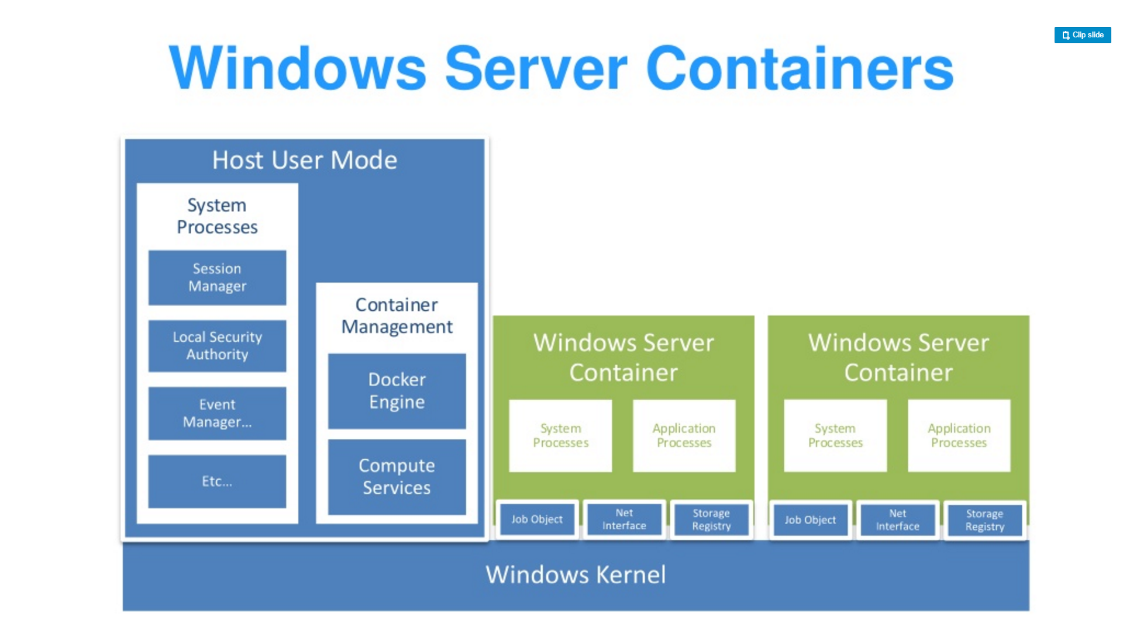
Source: “DockerCon 16: Windows Server & Docker - The Internals Behind Bringing Docker & Containers to Windows - Black Belt”

Slide 68
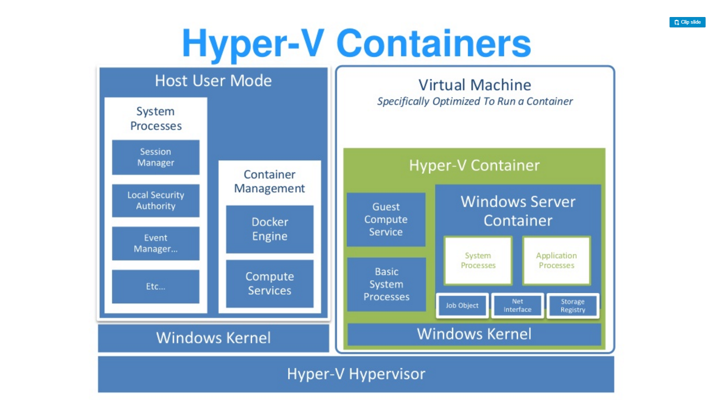
Source: “DockerCon 16: Windows Server & Docker - The Internals Behind Bringing Docker & Containers to Windows - Black Belt”

Slide 69
Container Types
Default in Windows 10
Small, stateless VM
  Writes are not persisted
Storage attached via SMB
  Over VMBus not networking
Physically map executables from the host file cache
Networking is a virtual nic
Cloning
  Launch utility VM
  Freeze State
  Fork the VM for each new instance
    No startup time
    Shares memory
Hyper-V Container
Source: https://en.wikipedia.org/wiki/UnionFS

Slide 70
More Information on Architecture
DockerCon 16: Windows Server & Docker - The Internals Behind Bringing Docker & Containers to Windows - Black Belt
https://channel9.msdn.com/Blogs/containers/DockerCon-16-Windows-Server-Docker-The-Internals-Behind-Bringing-Docker-Containers-to-Windows

Slide 71
Monoliths - Challenges
Scale
Security
Brittle

Slide 72
Monoliths - Challenges
OS Updates
Framework Updates
DLL Hell

Slide 73
N-Tier - Challenges
Scale
Security
Framework Version Maintenance
OS Compatibility
It Works on My Machine
VM Image Sprawl and Maintenance
Firewall Configuration

Slide 74
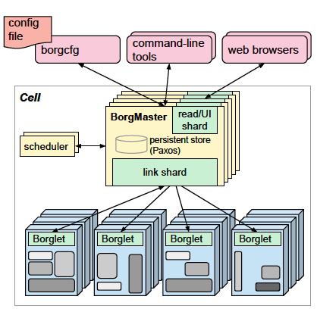
Kubernetes Lineage
Google Borg
Runs hundreds of thousands of jobs..
..for many thousands of different applications (YouTube, Search Index, Maps, etc.)..
..across a number of clusters (hundreds)..
..each with up to tens of thousands of machines..
Borg currently manages many millions of physical servers hosting billions of containers!
In production since 2003!
Offers a declarative job specification language, name service integration, real-time job monitoring, and tools to analyze and simulate system behavior.
Source: Large-scale cluster management at Google with Borg

Slide 75
Borg Lessons Learned
Some Borg features are cautionary tales, informing alternatives in Kubernetes...
The Bad
Jobs” are restrictive as the only grouping mechanism for tasks.
No first-class way to manage an entire multi-job service as a single entity, or to refer to related instances of a service (e.g., canary and production tracks).
Complex name parsing mechanisms as hacks.
Inflexible semantics as a consequence.
Resulting Kubernetes Construct
Labels! Highly flexible; enable multiple powerful levels of decoupling.
Sources: Borg, Omega, and Kubernetes Lessons learned from three container-management systems over a decade , Burns Et Al. ,System Evolution, ACM Queue Vol. 14, Iss. 1 & Apprenda K8S Training

Slide 76
Borg Lessons Learned
Some Borg features are cautionary tales, informing alternatives in Kubernetes...
The Bad
One IP address per machine complicates things!
Borg tasks all use the single IP address of their host, and share host’s port space…
Issues:
  Borg must schedule ports as a resource;
  tasks must pre-declare how many ports they need, and be willing to be told which ones to use when they start;
  the Borglet must enforce port isolation; and the naming;
  RPC systems must handle ports as well as IP addresses…
Resulting Kubernetes Construct
Unique, routable IP per Pod! Let the user choose ports; user friendly; no port mgmt.
Sources: Borg, Omega, and Kubernetes Lessons learned from three container-management systems over a decade , Burns Et Al. ,System Evolution, ACM Queue Vol. 14, Iss. 1 & Apprenda K8S Training

Slide 77
Borg Lessons Learned
Some Borg features have stood the test of time!
The Good
Allocs are useful!
A Borg alloc (short for allocation) is a reserved set of resources on a machine in which one or more tasks can be run.
Enables helper services / co-scheduled tasks (containers).
Resulting Kubernetes Construct
The K8s equivalent for allocs are Pods!
Sources: Borg, Omega, and Kubernetes Lessons learned from three container-management systems over a decade , Burns Et Al. ,System Evolution, ACM Queue Vol. 14, Iss. 1 & Apprenda K8S Training

Slide 78
Borg Lessons Learned
Some Borg features have stood the test of time!
The Good
Cluster management is more than task management...
Applications that run on Borg benefit from many other cluster services, including naming and load balancing.
Resulting Kubernetes Construct
Services! Inter/cross-cluster VIPs that dynamically attach to Pods based on Label Selectors.
Sources: Borg, Omega, and Kubernetes Lessons learned from three container-management systems over a decade , Burns Et Al. ,System Evolution, ACM Queue Vol. 14, Iss. 1 & Apprenda K8S Training

Slide 79
Borg Lessons Learned
Some Borg features have stood the test of time!
The Good
Introspection is vital.
Borg surfaces debugging information to all users rather than hiding it: Borg has thousands of users, so “self-help” has to be the first step in debugging.
Several levels of UI and debugging tools are available so users can quickly identify anomalous events related to their jobs, and then drill down to detailed event and error logs from their applications and the infrastructure itself.
Resulting Kubernetes Construct
Many introspection techniques such as cAdvisor / Fluentd / ElasticSearch
Sources: Borg, Omega, and Kubernetes Lessons learned from three container-management systems over a decade , Burns Et Al. ,System Evolution, ACM Queue Vol. 14, Iss. 1 & Apprenda K8S Training

Slide 80
We have containers. Now What?
Isolation: Keep jobs from interfering with each other
Scheduling: Where should my job be run?
Lifecycle: Keep my job running
Discovery: Where is my job now?
Constituency: Who is part of my job?
Scale-up: Making my jobs bigger or smaller
Auth{n,z}: Who can do things to my job?
Monitoring: What’s happening with my job?
Health: How is my job feeling?

Slide 81
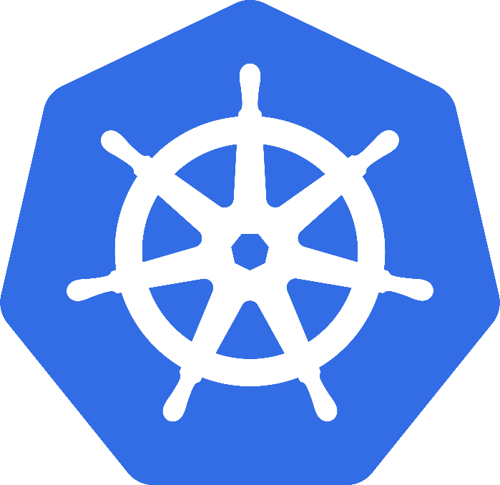
Evolution: Kubernetes
Greek for “Helmsman”; also the root of the word “Governor”
Google’s 3rd Container Platform (Borg, Omega)
Set of compossable building blocks
Container orchestrator
Runs Docker / Rkt / Linux containers / Windows Containers
Supports multiple cloud and bare-metal environments
Built on lessons learned from Borg and Omega
Written in Go
Manage applications, not machines
*Kubernetes Currently in Alpha see SIG-Windows
Notes:
Omega: Raw State
Omega: Multiple Schedulers, Compossable building blocks

Slide 82
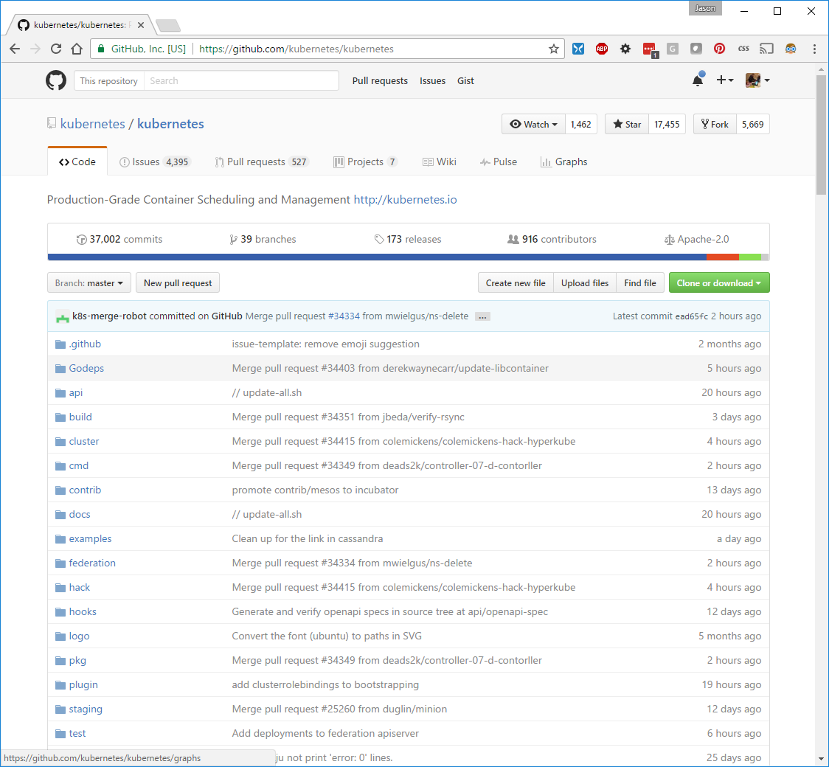

Slide 83
Key Concepts
Container: An application package (Docker / Rocket)
Pod: A small group of tightly coupled Containers
Controller: A loop that drives current state towards desired state
Service: A set of running pods that work together
Labels: Identifying metadata attached to other objects
Selector: A query against labels, producing a set result

Slide 84
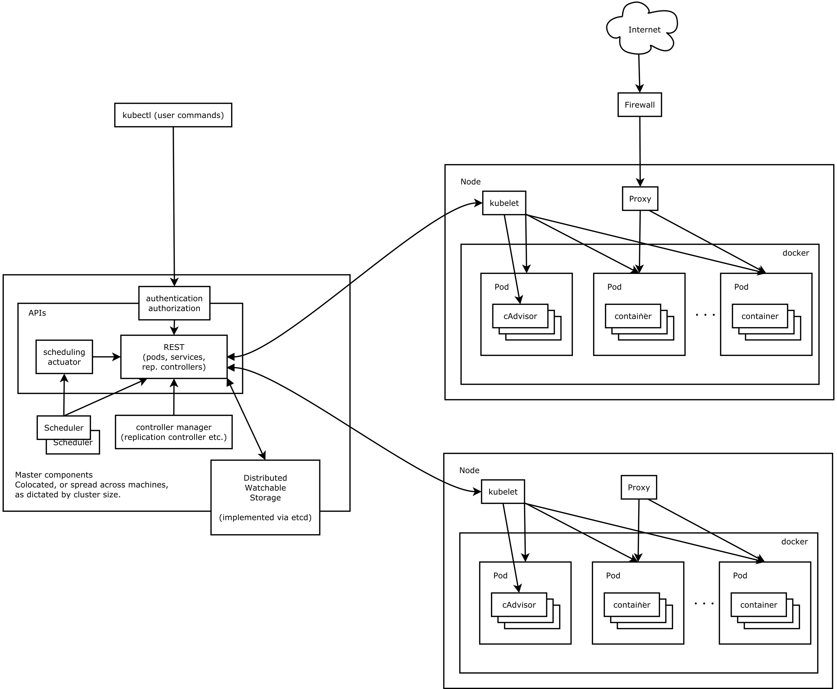
Architecture
Source: https://github.com/kubernetes/kubernetes/blob/release-1.4/docs/design/architecture.md

Slide 85
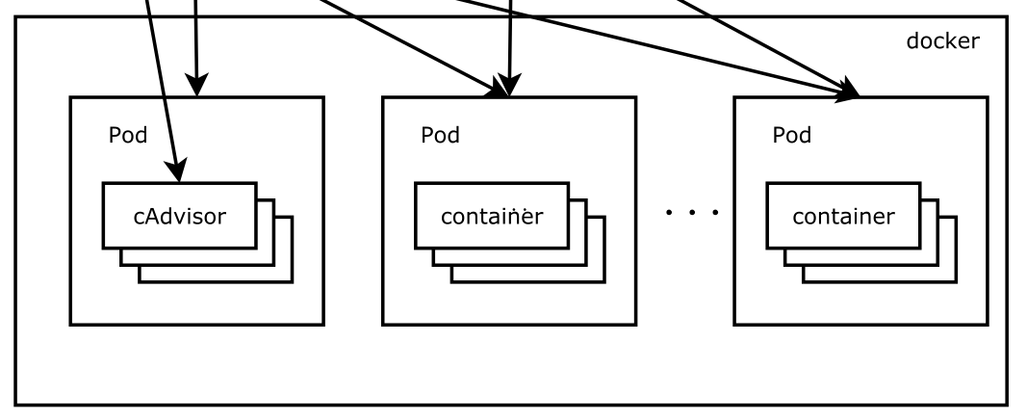
Pods
Source: https://github.com/kubernetes/kubernetes/blob/release-1.4/docs/design/architecture.md

Slide 86
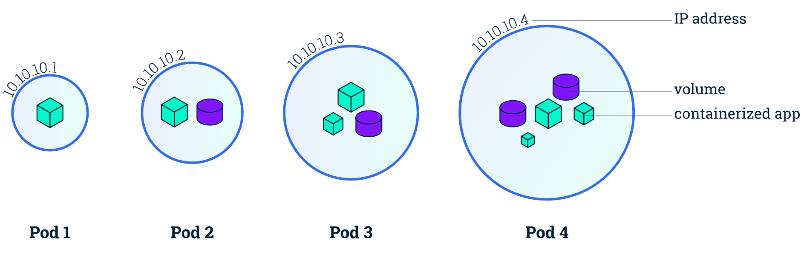
Pods
Small group of containers & volumes
  Tightly coupled
  Always on the same node
Atomic unit of cluster scheduling & placement
Shared namespace, IP and localhost
Ephemeral

Slide 87
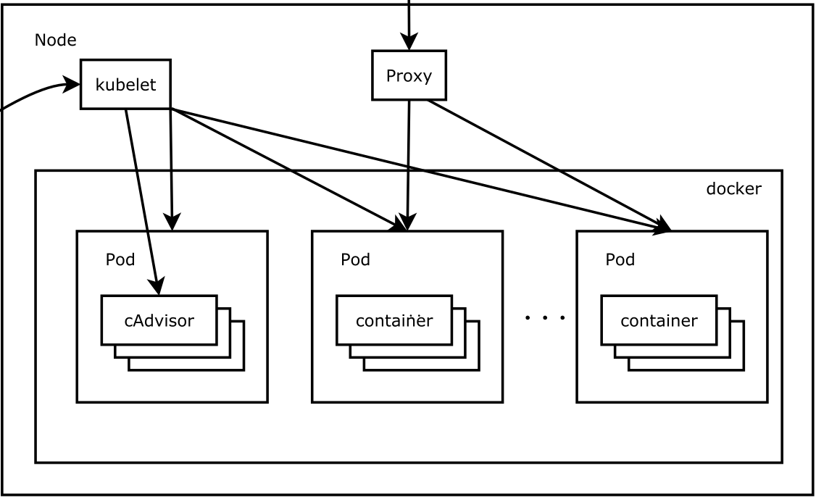
Nodes
Source: https://github.com/kubernetes/kubernetes/blob/release-1.4/docs/design/architecture.md

Slide 88
Nodes
Worker Machine
Physical or Virtual
Each node runs kubelet
  Manages pods, containers, images and volumes
Each node runs kube-proxy
  Simple network proxy and load balancer supporting services

Slide 89
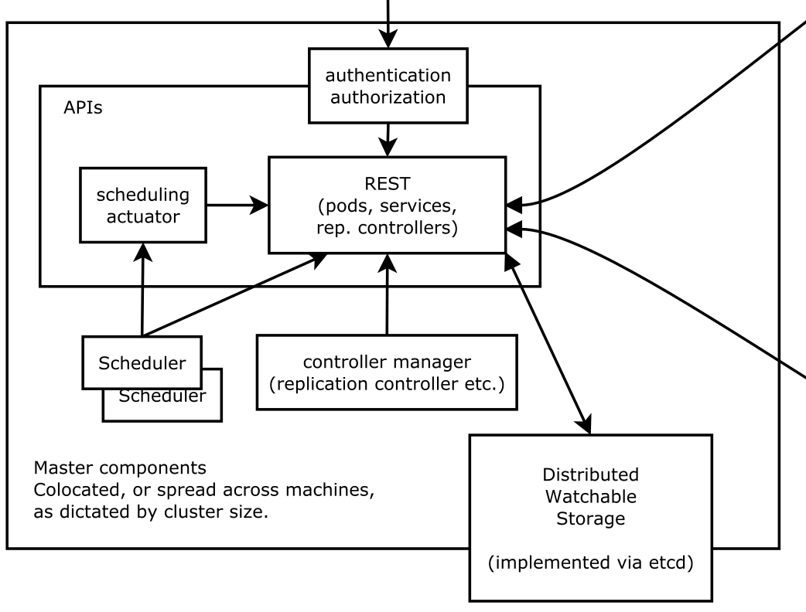
Master Node
Source: https://github.com/kubernetes/kubernetes/blob/release-1.4/docs/design/architecture.md

Slide 90
Master Node
Controls the cluster
Schedules all pods within the cluster
Not currently H/A (This is changing)
Very modular
Provides control and introspection of the cluster through REST API
Permanent master state managed by etcd
All other cluster-level functions are currently performed by the Controller Manager.
  Endpoints objects are created and updated by the endpoints controller
  Nodes are discovered, managed, and monitored by the node controller.
  Replication Controller

Slide 91
Pod Networking
Pod IPs are routable
Docker default is private IP
Pods can reach each other without NAT
even across nodes
No brokering of port numbers
This, fundamental requirement is a lessoned learned from Borg & Omega
several SDN solutions

Slide 92
Labels
App: Nifty
Phase: Dev
Role: FE
App: Nifty
Phase: Dev
Role: BE
Arbitrary metadata
Attached to any API object
Generally represent identity
Queryable by selectors
think SQL ‘select ... where ...’
The only grouping mechanism
pods under a ReplicationController
pods in a Service
capabilities of a node (constraints)
App: Nifty
Phase: Test
Role: FE
App: Nifty
Phase: Test
Role: BE

Slide 93
Selectors
App: Nifty
Phase: Dev
Role: FE
App: Nifty
Phase: Dev
Role: BE
App: Nifty
Phase: Test
Role: FE
App: Nifty
Phase: Test
Role: BE

Slide 94
Selectors
App == Nifty
App: Nifty
Phase: Dev
Role: FE
App: Nifty
Phase: Dev
Role: BE
App: Nifty
Phase: Test
Role: FE
App: Nifty
Phase: Test
Role: BE

Slide 95
Selectors
App == Nifty
Role == FE
App: Nifty
Phase: Dev
Role: FE
App: Nifty
Phase: Dev
Role: BE
App: Nifty
Phase: Test
Role: FE
App: Nifty
Phase: Test
Role: BE

Slide 96
Selectors
App == Nifty
Role == BE
App: Nifty
Phase: Dev
Role: FE
App: Nifty
Phase: Dev
Role: BE
App: Nifty
Phase: Test
Role: FE
App: Nifty
Phase: Test
Role: BE

Slide 97
Selectors
App == Nifty
Phase == Dev
App: Nifty
Phase: Dev
Role: FE
App: Nifty
Phase: Dev
Role: BE
App: Nifty
Phase: Test
Role: FE
App: Nifty
Phase: Test
Role: BE

Slide 98
Selectors
App: Nifty
Phase: Dev
Role: FE
App: Nifty
Phase: Dev
Role: BE
App == Nifty
Phase == Test
App: Nifty
Phase: Test
Role: FE
App: Nifty
Phase: Test
Role: BE

Slide 99
Control Loops
observe
act
Drive current state -> desired state
Act independently
APIs - no shortcuts or back doors
Observed state is truth
Recurring pattern in the system
Example: ReplicationController
diff

Slide 100
Replication Controllers
Replication Controller
Name = “nifty-rc”
Selector = {“App”: “Nifty”,
"Phase": "Dev",
"Role": "FE"}
PodTemplate = { ... }
NumReplicas = 4

Slide 101
Replication Controllers
Replication Controller
Desired = 4
Current = 4
node 3
node 1
b0111
f0118
node 2
node 4
d9376
a1209

Slide 102
Replication Controllers
Replication Controller
Desired = 4
Current = 4
node 3
node 1
b0111
f0118
node 2
node 4
d9376
a1209

Slide 103
Replication Controllers
Replication Controller
Desired = 4
Current = 3
node 3
node 1
b0111
f0118
node 4
a1209

Slide 104
Replication Controllers
Replication Controller
Desired = 4
Current = 4
node 3
node 1
b0111
f0118
c9bad
node 4
a1209

Slide 105
Services
Client
A group of pods that act as one == Service
group == selector
Defines access policy
only “load balanced” for now
Gets a stable virtual IP and port
called the service portal
also a DNS name
VIP is captured by kube-proxy
watches the service constituency
updates when backends change
Hide complexity - ideal for non-native apps
Portal (VIP)

Slide 106
Service
Name = “nifty-svc”
Selector = {“App”: “Nifty”}
Port = 9376
ContainerPort = 8080
Portal IP is assigned
Client
Services
TCP / UDP
10.0.0.1 : 9376
iptables
DNAT
kube-proxy
apiserver
TCP / UDP
watch
10.240.1.1 : 8080
10.240.2.2 : 8080
10.240.3.3 : 8080

Slide 107
Getting Started
Kubernetes Bootcamp
  https://kubernetesbootcamp.github.io/kubernetes-bootcamp/
Kubernetes 101 (User Guide)
  http://kubernetes.io/docs/user-guide/walkthrough/
Kubernetes Labs
  https://www.katacoda.com/courses/kubernetes
Kubernetes up and Running
  http://shop.oreilly.com/product/0636920043874.do
Kubernetes The Hard Way
  https://github.com/kelseyhightower/kubernetes-the-hard-way

Slide 108
Commercial Products Supporting Kubernetes
Platforms: Red Hat OpenShift / Apcera HCOS / Engine Yard DEIS / Eldarion Gondor / WSO2 Stratos / Apprenda
CI/CD: Travis / Jenkins / TeamCity / Werker / CircleCI / Shippable …
Container Registry: AWS EC2 Container Registry / GCR / CoreOS Quay / Docker Hub …
Tracing Frameworks: GRPC / appdash / Linkerd / Hystrix …
Monitoring: Sysdig / Datadog / New Relic …
Logging: ElasticSearch / Fluentd / Flume / logstash …

